Slide 1

Shelterly Overview
February 2025

Slide 2
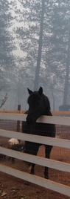
What is Shelterly?
Shelterly is an animal disaster response technology organization
  Provides mutual aid, preparedness training, and operational resources to animal response teams, municipal shelters, and communities
  Shelterly nonprofit founded by Trevor Skaggs
  Shelterly streamlines animal response information so teams can focus on helping animals
The Shelterly platform is an animal disaster response operating system
  Supports management and tracking of animals throughout an entire incident (hotline call, field operations, sheltering, veterinary care, and reunification)
    Improves efficiency and reduces manual processes and errors
  Cloud-based software
  Created in the aftermath of the 2018 Camp Fire, to address the paperwork inefficiencies of caring for over 10,000 animals

Slide 3
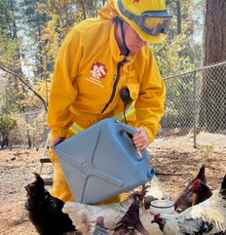
Why Shelterly?
Proven in the field and trusted by frontline responders
  Successfully deployed in:
    2023 Lahaina Fire (Maui)
    2024 Apache, Thompson, and Park Fires (Butte county)
    2025 Eaton and Palisades Fires (LA county)
Designed to reduce administrative burdens so teams can focus on saving lives
User-friendly technology that works even in high-stress scenarios
Scalable and flexible to meet the evolving needs of disaster response organizations
Emerging standard for CARTs, endorsed by Cal CARTs
Those who have tried Shelterly say: “Never going back to the old way”

Slide 4

Shelterly Training
Shelterly Overview (this presentation)
  Awareness of main Shelterly workflows and how they are used
  Awareness of how data is organized in Shelterly
  Awareness of different Shelterly operator roles
Hands-on Trainings – demo and hands-on practice
  Hotline
  Intake
  Dispatch
  Debrief
  Vetmed
  Admin
Shelterly Quick Reference document library

Slide 5
Shelterly Workflow
Enter Service Requests (SRs) via Hotline workflow
Assign SRs to Evac teams (Dispatch) via Deploy Teams workflow
  Use map to group SRs together
  Evac teams take printout of Dispatch Assignment and make notes on printout
  Additional SR assignments delivered to field team via radio and/or pdfs in WhatsApp or other app
Intake animals at shelter via Shelter workflow
  Update status of each animal and enter their shelter location
  Can intake animals delivered by an Evac team, or can intake directly from members of the public bringing animals to shelter
Debrief Evac teams as they return to staging via Resolve Dispatch Assignment workflow
  Update all SRs – animal status, visit notes, follow-up date
(As needed) Initiate veterinary care via Vet Request workflow
  Creates Medical Record (MR) for animal, vet can then enter exam notes and make treatment plan

Slide 6

Data in Shelterly
Searchable Items – each has unique ID#
Service Requests (SRs)
Animals
Owners
Dispatch Assignments
Managed by Shelterly Admin
Shelterly Users (login credentials and permissions)
Shelters
Team Members (of Evac Teams)
Incidents
  Training vs. Real Incidents: Shelters and Team Members created in a Training incident are accessible in all other Training incidents, but not in Real incidents (and vice versa)
Training incident

Slide 7
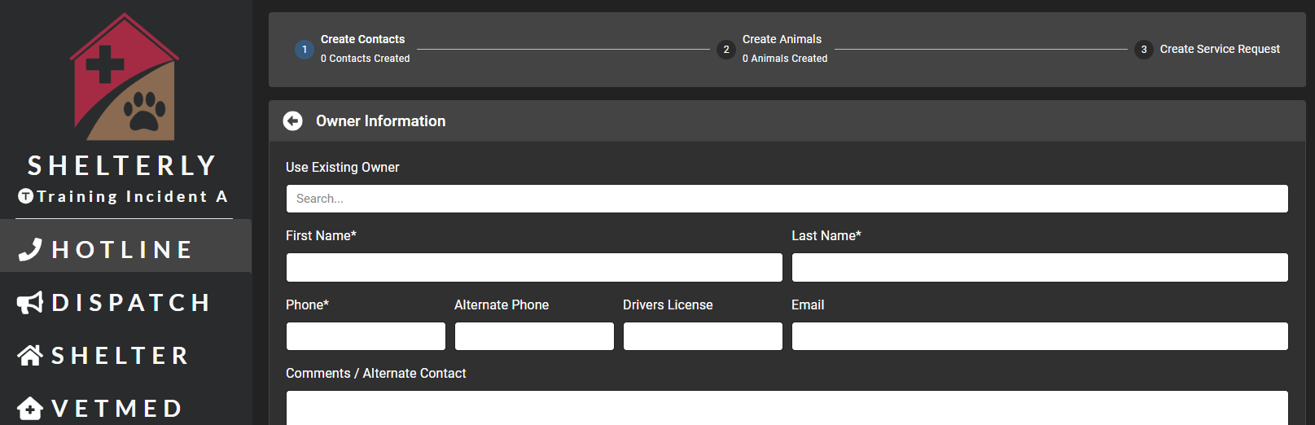
Shelterly Roles: Hotline Operator
  Duties: Answers phone and gets all SR information from caller
  Location: Can be at Staging or remote
  Notes: Can enter info directly into Shelterly during call, or fill out paper Shelterly SR form and then transfer info into Shelterly after call complete.

Slide 8
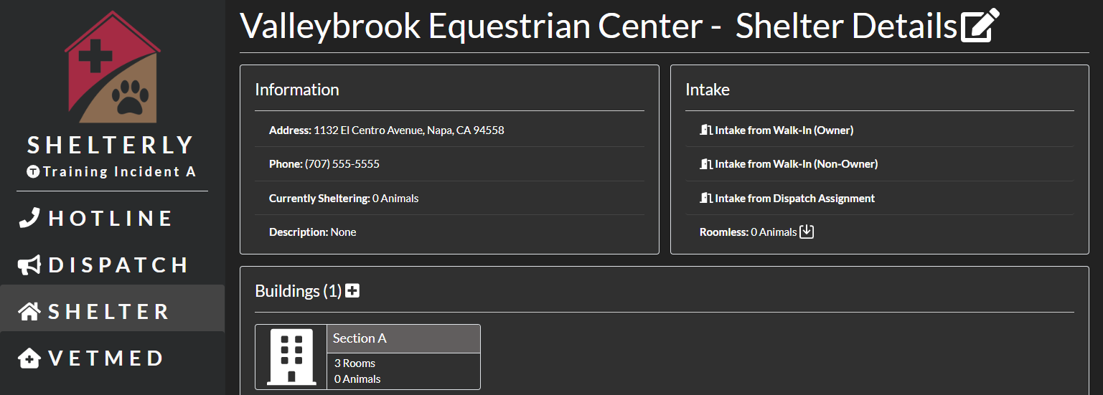
Shelterly Roles: Intake Specialist
  Duties: For animals brought by Evac, updates animal status/location; for animals dropped off by public, enters all animal and owner info
  Location: At Shelter
  Notes: Ideally uses tablet for data entry at Evac’s or Owner’s vehicle.

Slide 9
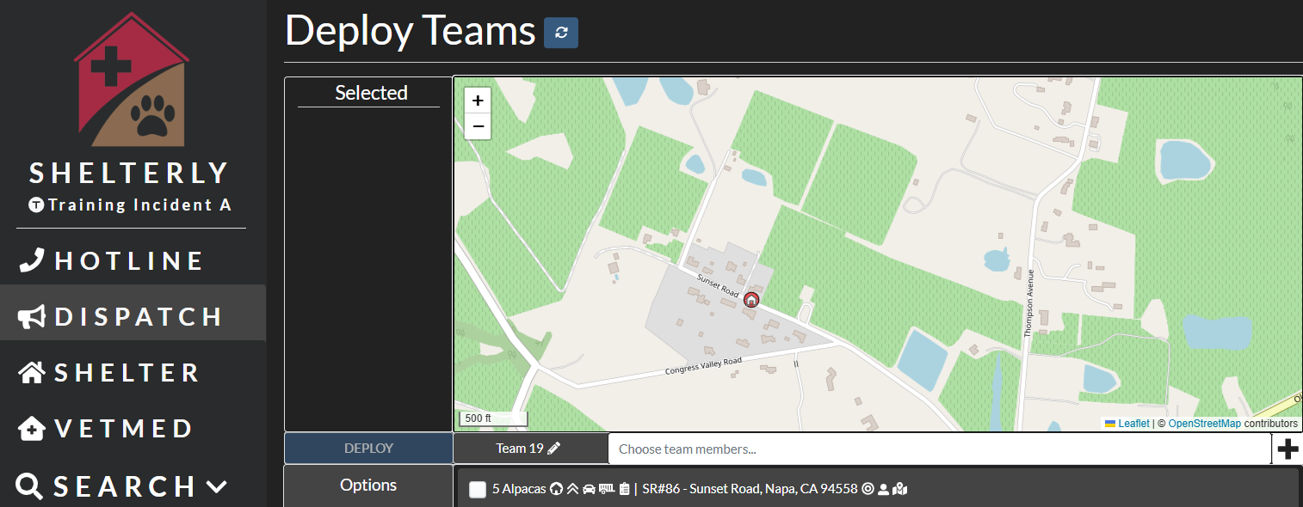
Shelterly Roles: Dispatcher
  Duties: Batches SRs by location and/or resources needed, and assigns to Evac teams (with input from Operations Chief / Animal Branch Director)
  Location: At Staging
  Notes: This role is typically separate from Comms / Scribe / Tracking Board roles. Shelterly Dispatcher asks Comms to convey new assignments to teams in field.

Slide 10
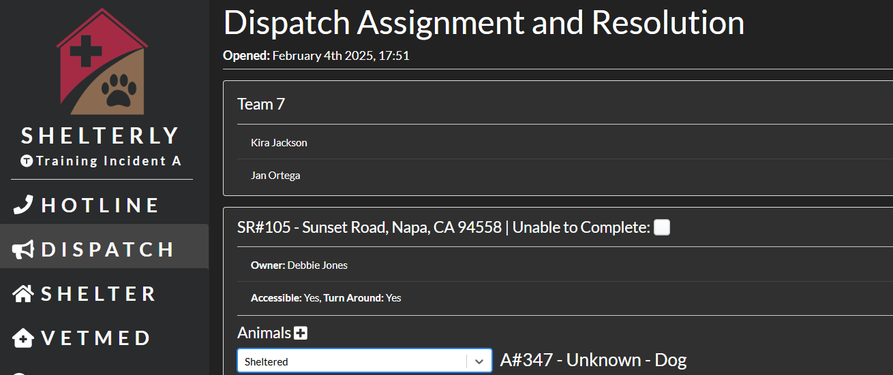
Shelterly Roles: Debriefer
  Duties: Interviews returning Evac teams and enters all updates into Shelterly
  Location: Can be at Staging or remote
  Notes: For small/medium incidents, Dispatcher and Debriefer are typically the same person.

Slide 11
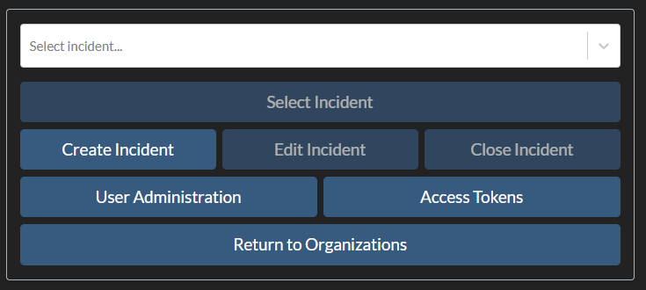
Shelterly Roles: Shelterly Admin
Creates incidents, manages Shelterly user access, creates shelters, etc.

Slide 12
Shelterly Roles - Recap
Hotline Operator
  Duties: Answers phone and gets all SR information from caller
  Location: Can be at Staging or remote
  Notes: Can enter info directly into Shelterly during call, or fill out paper Shelterly SR form and then transfer info into Shelterly after call complete.
Intake Specialist
  Duties: For animals brought by Evac, updates animal status/location; for animals dropped off by public, enters all animal and owner info
  Location: At Staging
  Notes: Ideally uses tablet for data entry at Evac’s or Owner’s vehicle.
Dispatcher
  Duties: Batches SRs by location and/or resources needed, and assigns to Evac teams (with input from Operations Chief / Animal Branch Director)
  Location: At Staging
  Notes: This role is typically separate from Comms / Scribe / Tracking Board roles. Dispatcher asks Comms to convey new assignments to teams in field.
Debriefer
  Duties: Interviews returning Evac teams and enters all updates into Shelterly
  Location: Can be at Staging or remote
  Notes: For small/medium incidents, Dispatcher and Debriefer are typically the same person.
Shelterly Lead – creates incidents, manages Shelterly user access

Slide 13
Shelterly / CalTopo Integration
Shelterly integrates with CalTopo Team Account
Shelterly Service Requests can be exported to the shared CalTopo incident map
CalTopo map capabilities include:
Real-time location sharing from each field team to the incident map
View locations of Shelterly Service Requests
View road closures and other hazards (as identified by Evac teams or Planning)
Offline map downloads for use by field teams when no cell signal

Slide 14
Next Steps
Obtain a Shelterly User login from your Shelterly Lead or Admin
Login to Shelterly (https://app.shelterly.org)
Practice the different workflows
  Only use Training incidents (not Real incidents) when practicing
Use Chrome browser for best performance
Always verify you are in the correct incident
  Avoid using bookmarks

